Slide 1


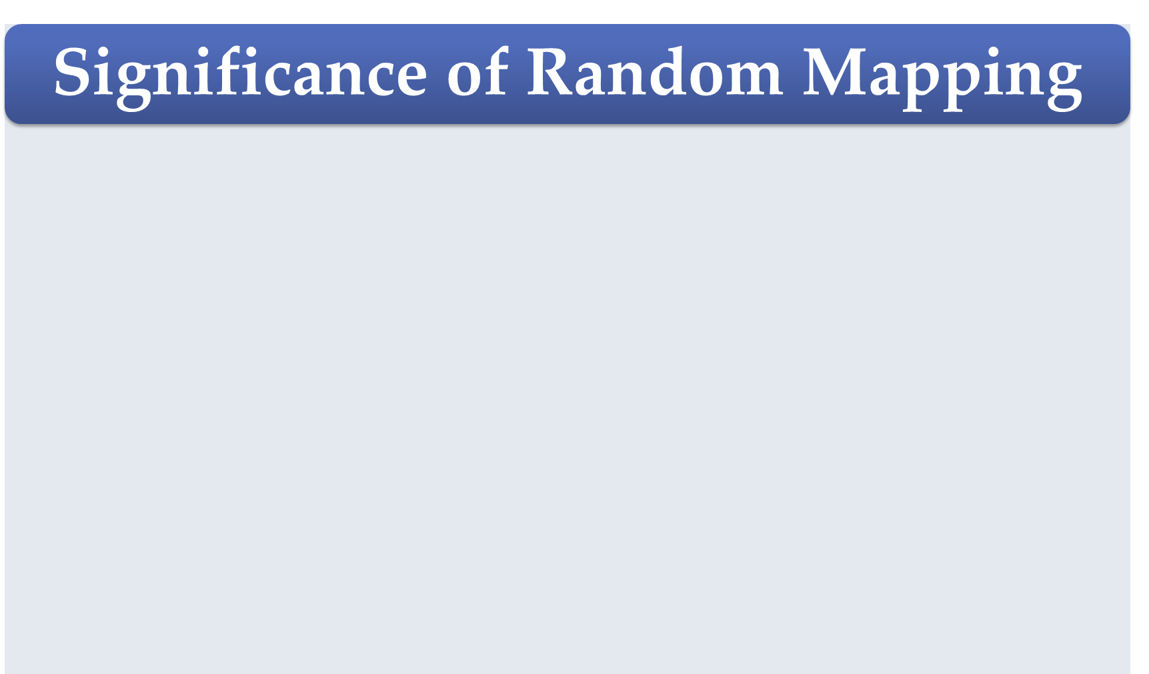
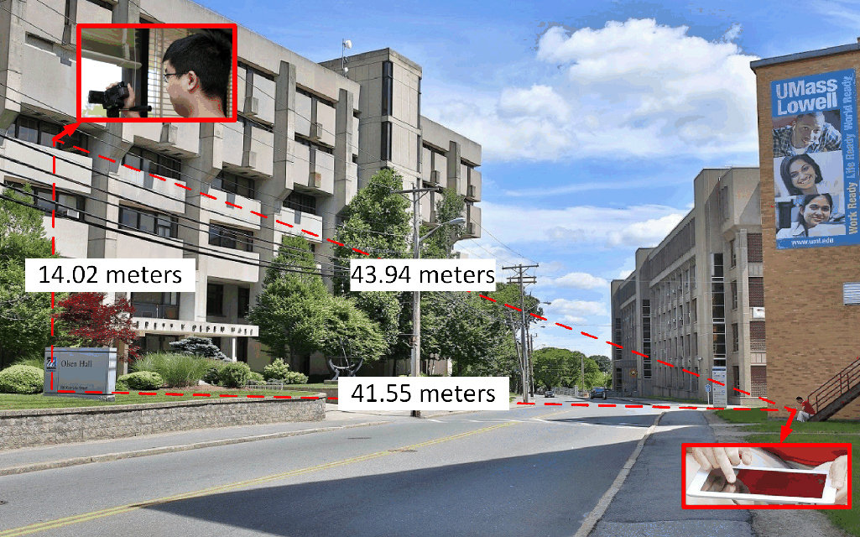

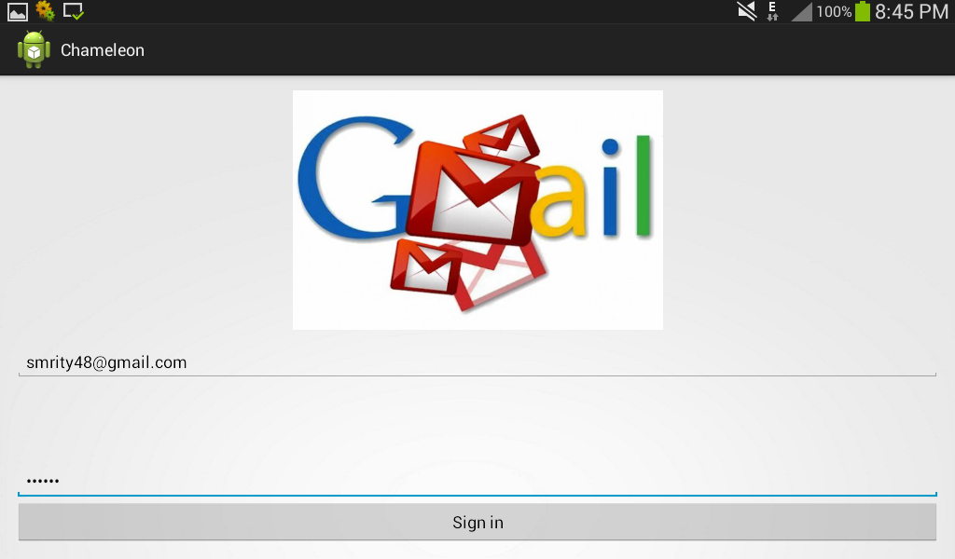
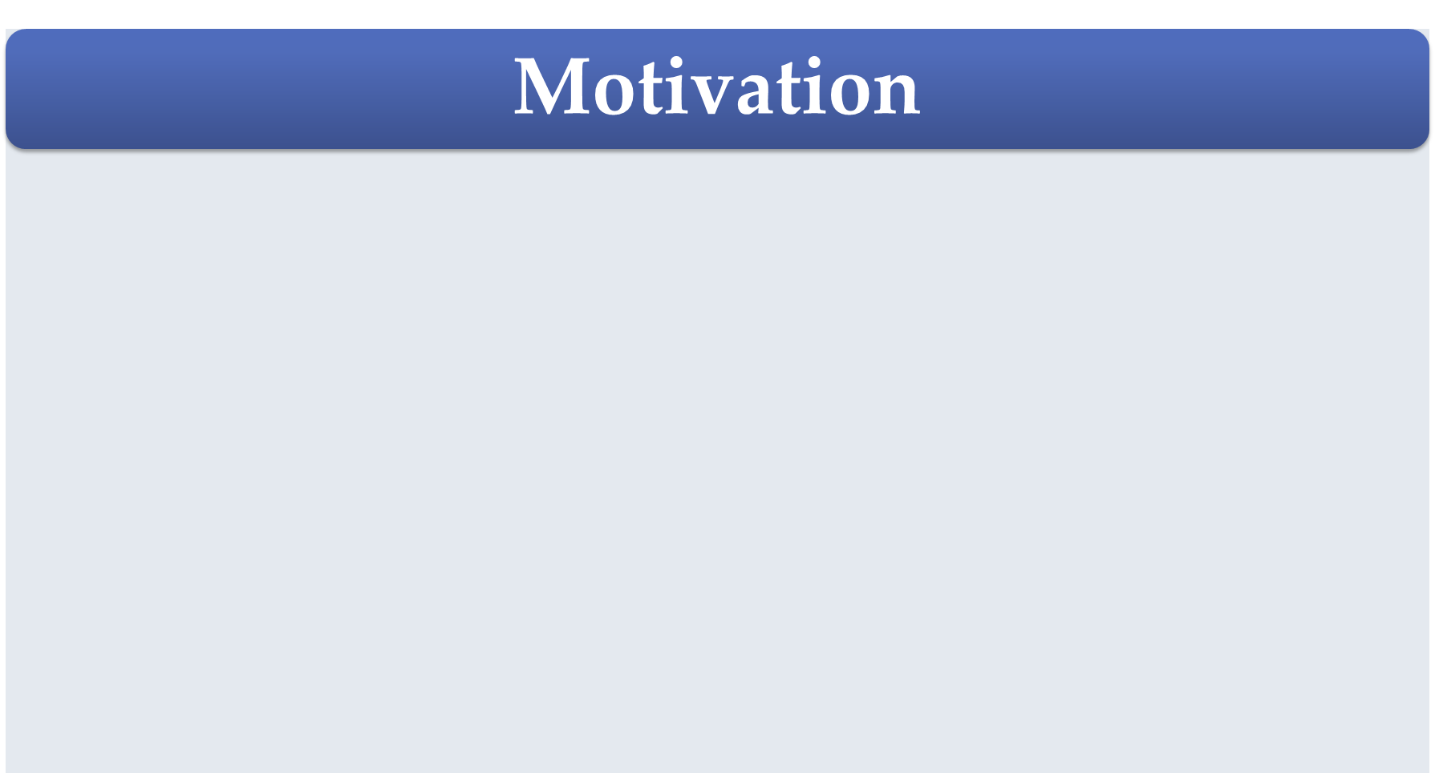
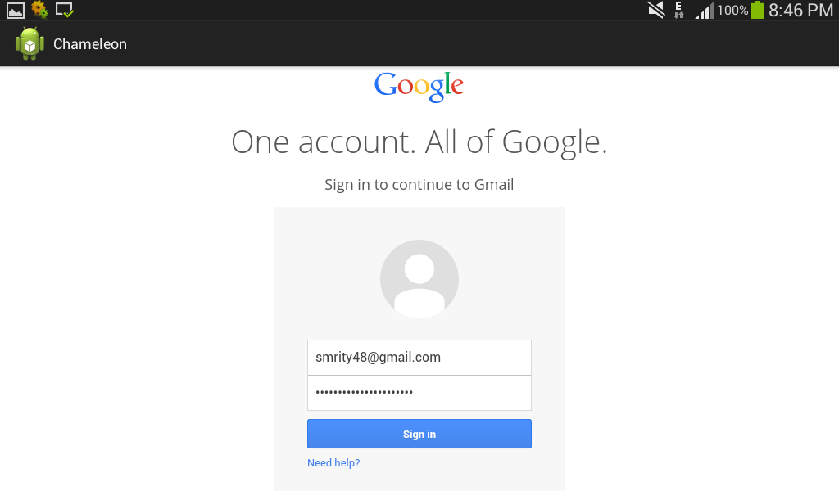
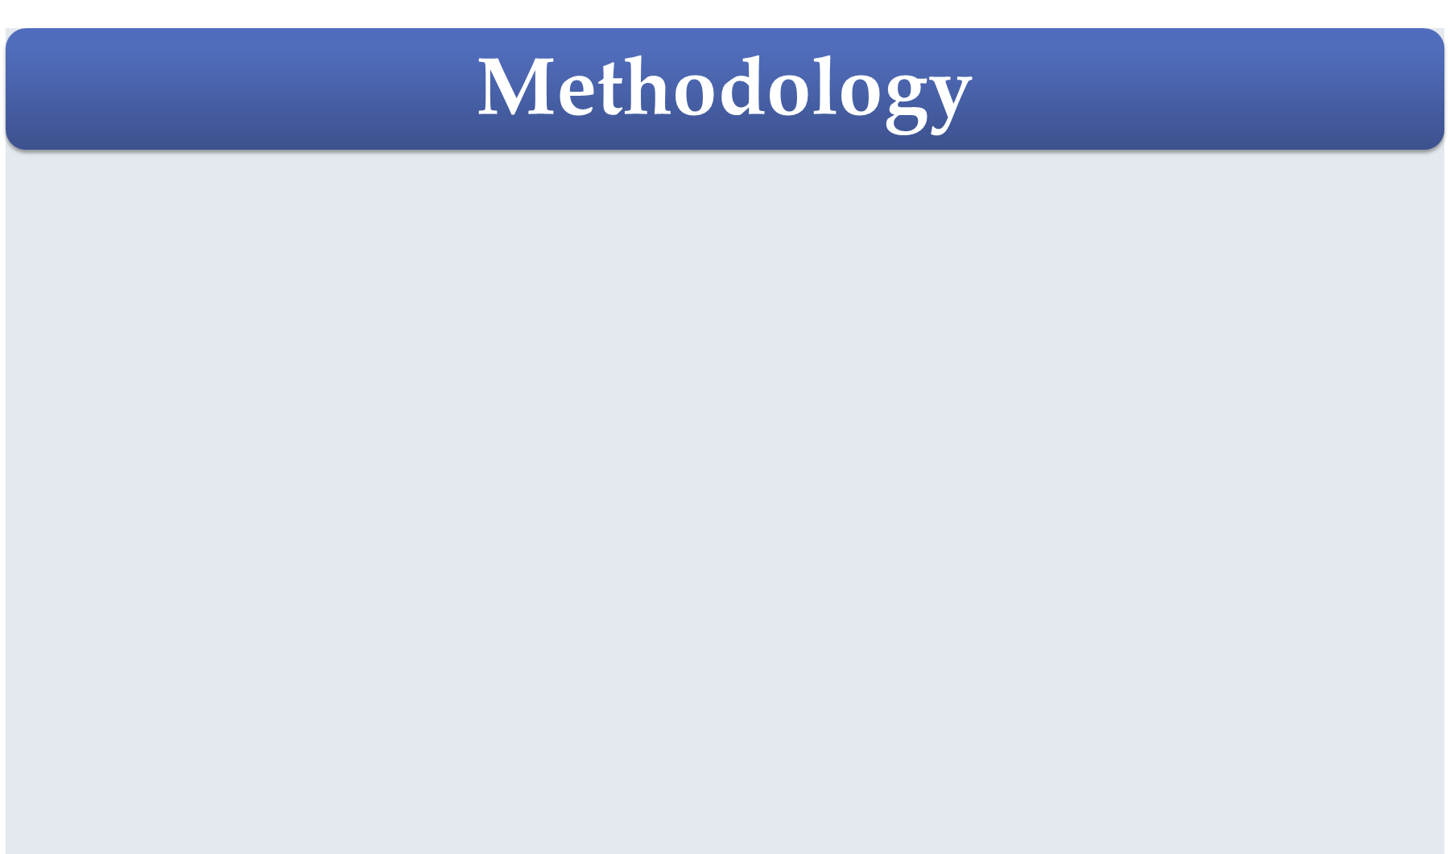
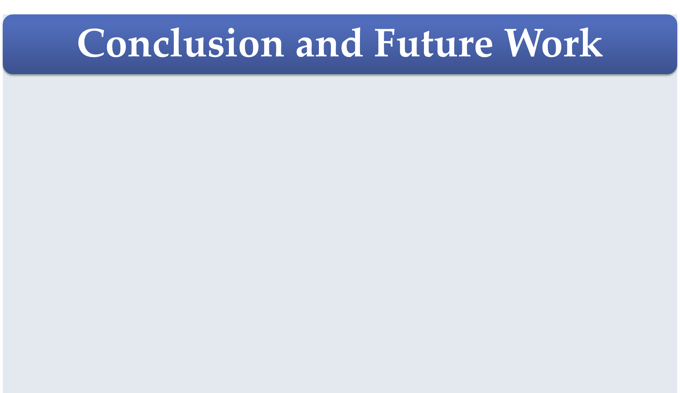
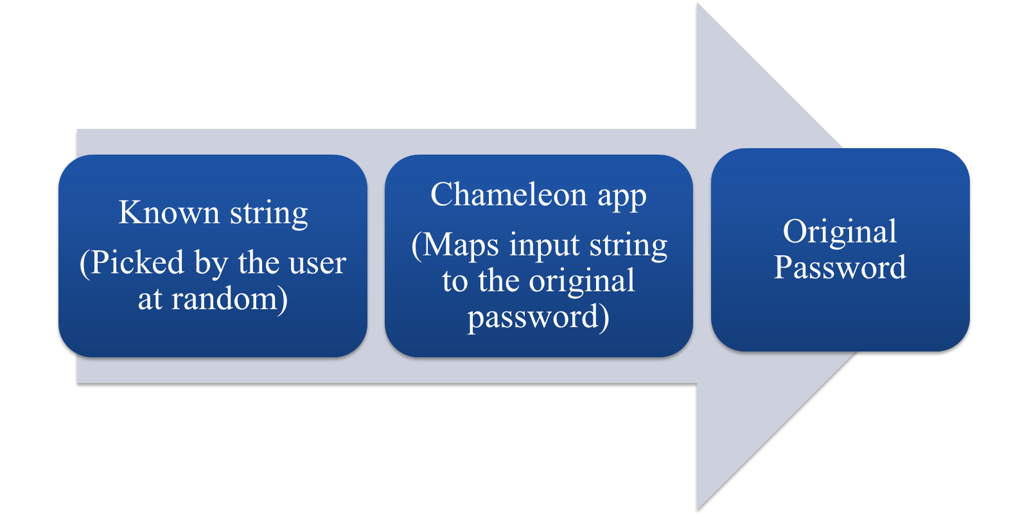

Chameleon: A Novel System for Defending Eavesdropping of Secret Information
Saiyma Sarmin
Email: 0905048.ss@ugrad.cse.buet.ac.bd
Eavesdropping of secret information is usually being prevented through using cryptography-based mechanisms.
Information can be eavesdropped even before being encrypted. Examples include the following:
  Surreptitiously capture four-digit PIN codes typed on an iPad
    Using high-definition camera from almost 43.94 meters away [1]
    Using wearable devices from almost 10 feet away [1]
  Analyzing the sound produced by keyboards [2]
  Observing the light reflected by the walls of a room [3]
  Monitoring somebody typing on keyboard [4]
Choosing the input string by the user himself makes the mapping completely random. Such random mapping avoids memorization needed in other cases such as for hashing.
The use of random input string chosen by the user enables to use a single device by multiple users.
  Random input string in Chameleon makes difficult to access the secret information by a malicious user even in case of the device being stolen.
Figure: Capturing PINs with camcorder from 44 meters away [1]
Figure: User enters pre-mapped random input string
A possible solution to prevent eavesdropping is to secure the information entry system.
  Recent research studies [5, 6, 7, 8] focus on securing the information entry system through using modified keyboard, complex pupil gesture, intricate mathematical/geometrical input, etc.
  Limitations of these studies: Resource-hungry, complex, and difﬁcult-to-use.
We propose to exploit the notion of string mapping mechanism to secure the information entry system.
    Advantages of our proposed mechanism: Light-weight, simple, and easy-to-use.
Figure: Chameleon maps random input string to the original password and feeds it to the target application
In this study, we presented a novel, simple, and easy-to-use system to protect user's confidential information from eavesdropping over physical environment, as the phenomena of eavesdropping has become of utmost significance in recent times.
In future, we plan to develop one-time user authentication mechanism through using usage data to protect the application.
  Such authentication will confirm almost no retrieval of the secret information from the system even for a device being stolen.
Google Glass Snoopers Can Steal Your Passcode With a Glance, March, 2015. Available: http://www.wired.com/2014/06/google-glass-snoopers-can-steal-your-passcode-with-a-glance/
B. Hoanca and K. Mock. Password Entry Scheme Resistant to Eavesdropping, Security and Management, Las Vegas, Nevada, 2008, pp. 119-125.
L. Sobrado, J. C. Birget, "Graphical passwords", The Rutgers Scholar, An Electronic Bulletin for Undergraduate Research, vol. 4 (2002).
N. Hopper and M. Blum. A Secure Human-Computer Authentication Scheme. Technical Re- port CMU-CS-00-139, Carnegie Mellon University, 2000.
Google Glass Snoopers Can Steal Your Passcode With a Glance, March, 2015. Available: http://www.wired.com/2014/06/google-glass-snoopers-can-steal-your-passcode-with-a-glance/
D. Asonov and R. Agrawal, Keyboard Acoustic Emanations. In Proceedings of the IEEE Symposium on Security and Privacy, pp. 3-11, 2004.
M. Kuhn, Time-Domain Eavesdropping Risks of CRT Displays. In Proceedings of the IEEE Symposium on Security and Privacy, pp. 3-18, 2002.
D. Balzarotti, M. Cova, G. Vigna, ClearShot: Eavesdropping on Keyboard Input from Video, In Proceedings of the IEEE Symposium on Security and Privacy, pp. 170-183, 2008.
B. Hoanca and K. Mock. Password Entry Scheme Resistant to Eavesdropping, Security and Management, Las Vegas, Nevada, pp. 119-125, 2008.
D. Tan, P. Keyani and M. Czerwinski, Spy-resistant keyboard: more secure password entry on public touch screen displays, Proceeding OZCHI '05 Proceedings of the 17th Australia conference on Computer-Human Interaction: Citizens Online: Considerations for Today and the Future, pp. 1-10, 2005.
M. Kumar, T. Garfinkel, D. Boneh and T. Winograd. Reducing shoulder-surfing by using gaze-based password entry, Proceeding SOUPS '07 Proceedings of the 3rd symposium on Usable privacy and security, pp. 13-19, 2007.
Y. Wu, Z. Zhao, Enhancing the Security of On-line Transactions with CAPTCHA Keyboard, Information Security and Privacy Research, IFIP Advances in Information and Communication Technology Volume 376, pp 531-536, 2012.
Department of Computer Science and Engineering (CSE), BUET

